Slide 1
Pre-lab Questions(2.5 points each)

Slide 2
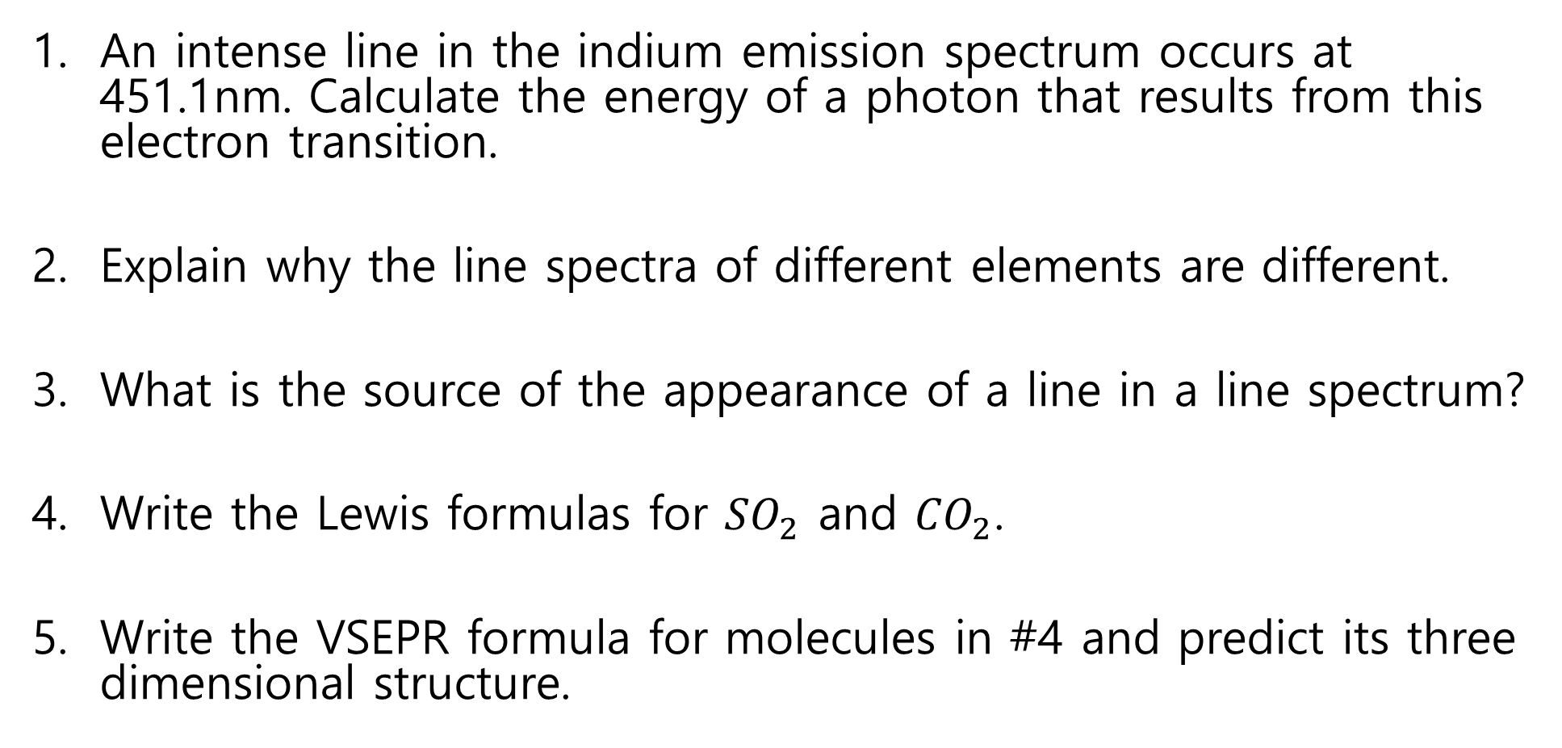
An intense line in the indium emission spectrum occurs at 451.1nm. Calculate the energy of a photon that results from this electron transition.
Explain why the line spectra of different elements are different.
What is the source of the appearance of a line in a line spectrum?
Write the Lewis formulas for ${SO}_{2}$ and ${CO}_{2}$.
Write the VSEPR formula for molecules in #4 and predict its three dimensional structure.

Slide 3
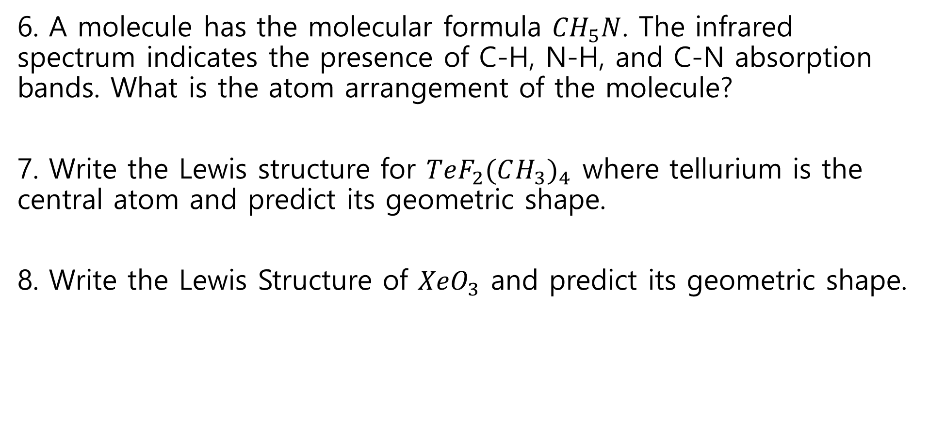
6. A molecule has the molecular formula ${CH}_{5}N$. The infrared spectrum indicates the presence of C-H, N-H, and C-N absorption bands. What is the atom arrangement of the molecule?
7. Write the Lewis structure for $TeF_{2}(CH_{3})_{4}$ where tellurium is the central atom and predict its geometric shape.
8. Write the Lewis Structure of ${XeO}_{3}$ and predict its geometric shape.

Slide 4
Laboratory Reports

Slide 5
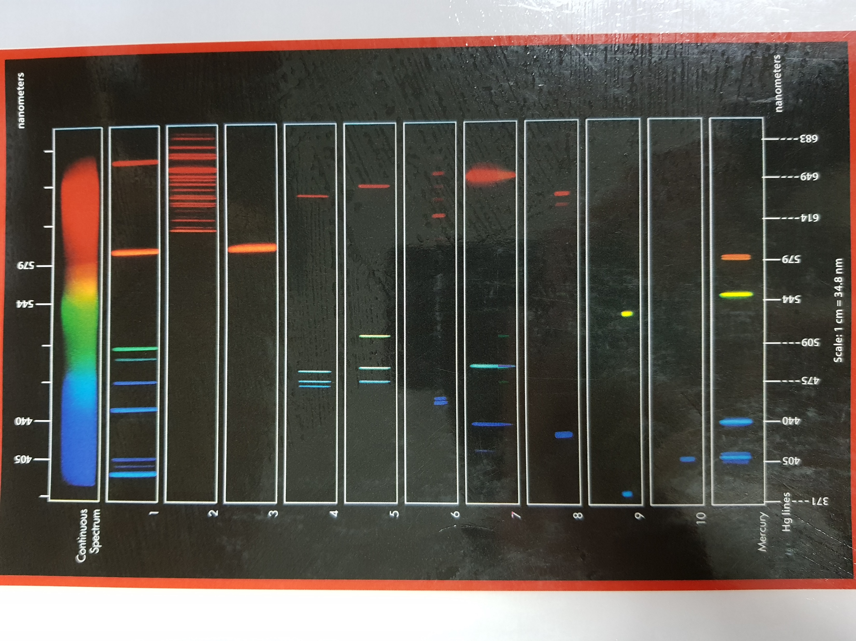
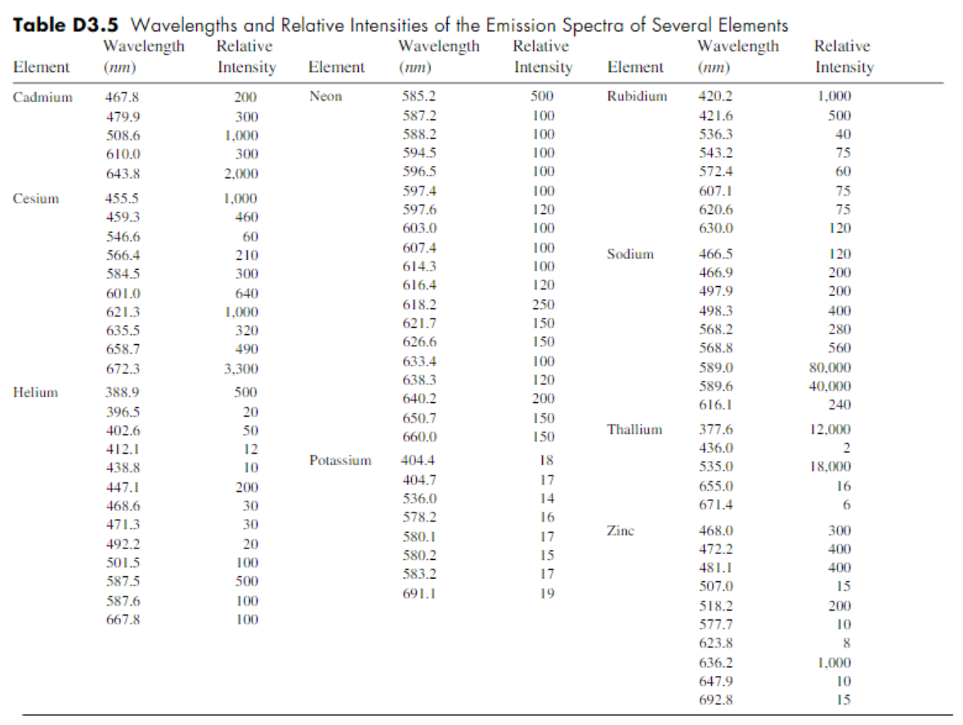
Assign an atom to each spectrum(1~10). Use table below and observed real spectra on video clip(04:14~05:00).
B. By referring to real spectra of four atoms on video clip, list the wavelength of peaks by nanometer(nm).

Slide 6
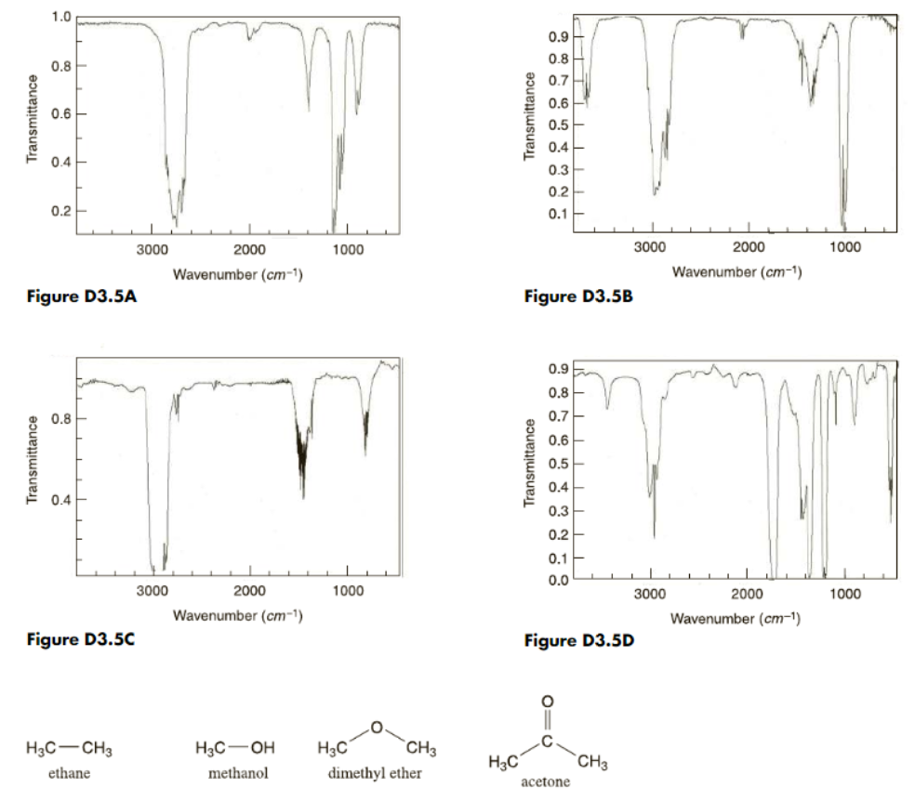
C. Match each spectrum with molecules shown in below.
Use table D3.2(05:03 on video).

Slide 7
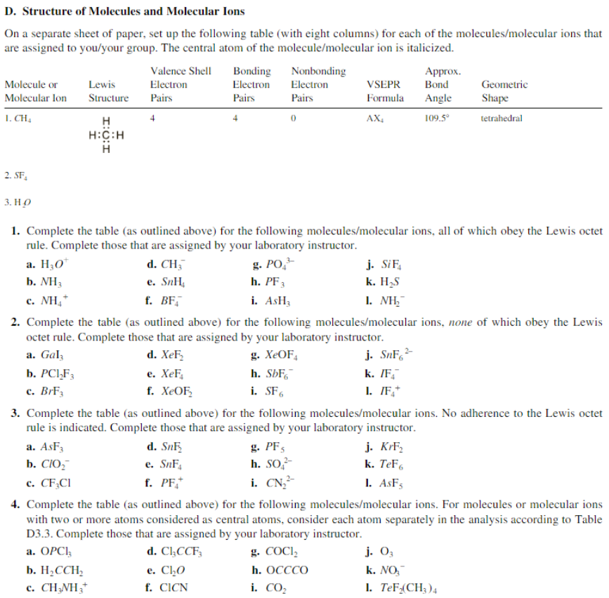
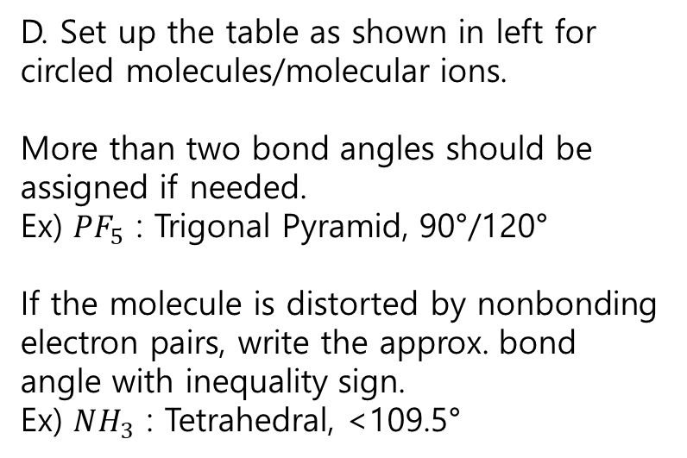
D. Set up the table as shown in left for circled molecules/molecular ions.
More than two bond angles should be assigned if needed.
Ex) ${PF}_{5}$ : Trigonal Pyramid, 90°/120°
If the molecule is distorted by nonbonding electron pairs, write the approx. bond angle with inequality sign.
Ex) $NH_{3}$ : Tetrahedral, <109.5°

Slide 8
Post-lab Questions (3 points each, maximum 20 points)

Slide 9
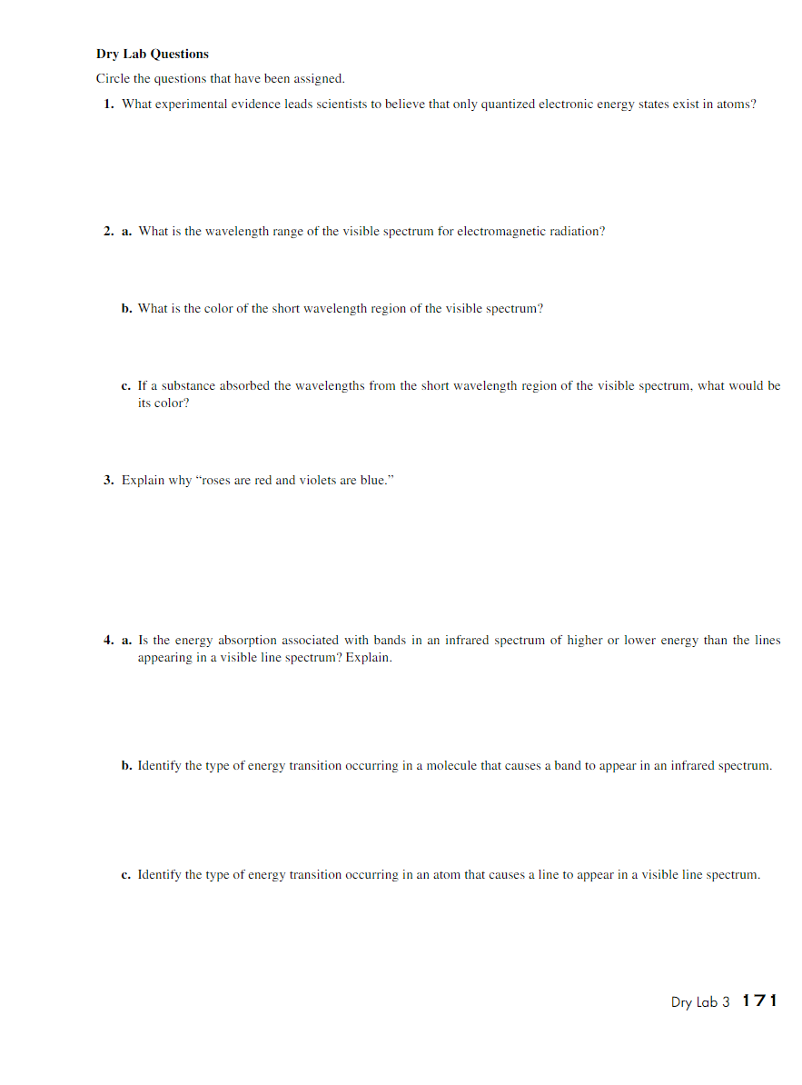
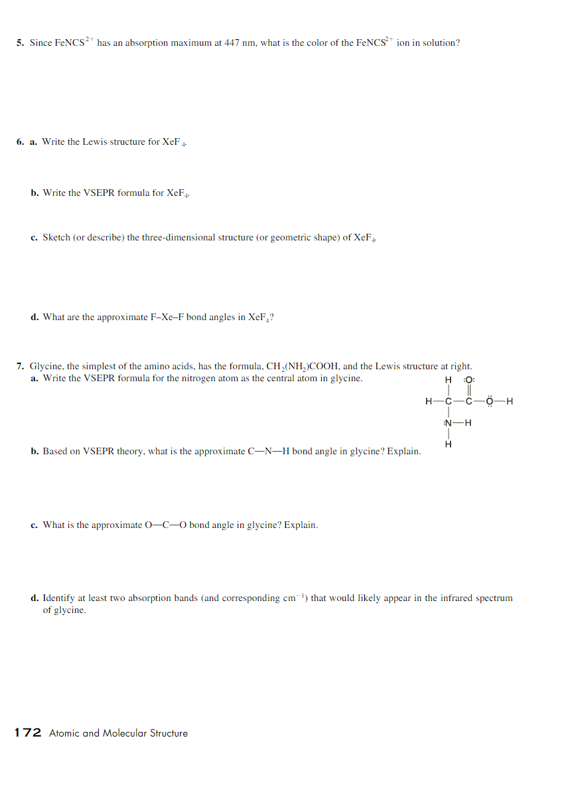

Slide 10
Textbook Content for Exp. 1

Slide 11
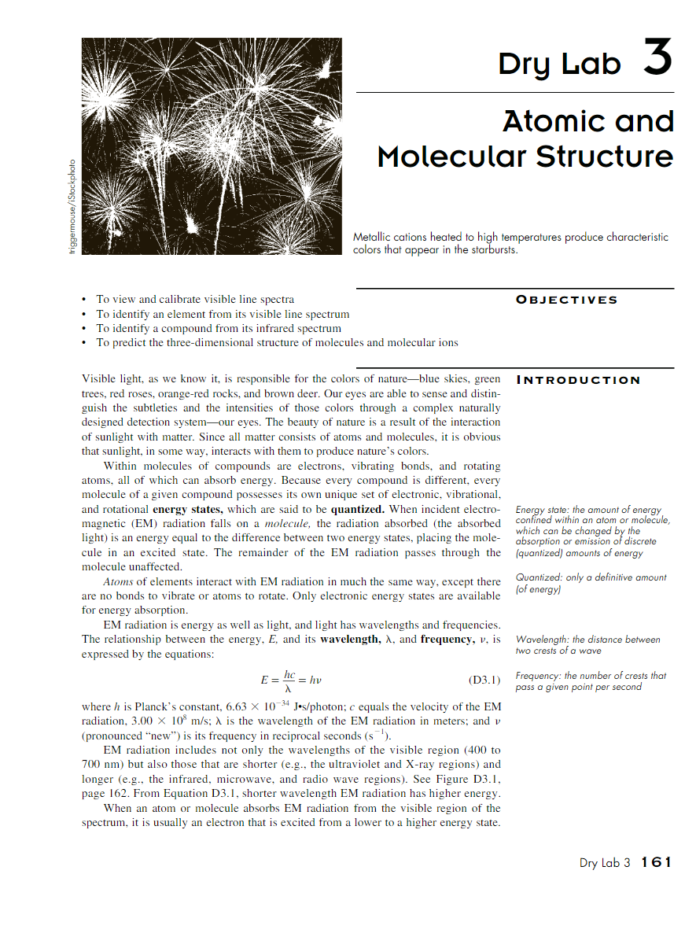
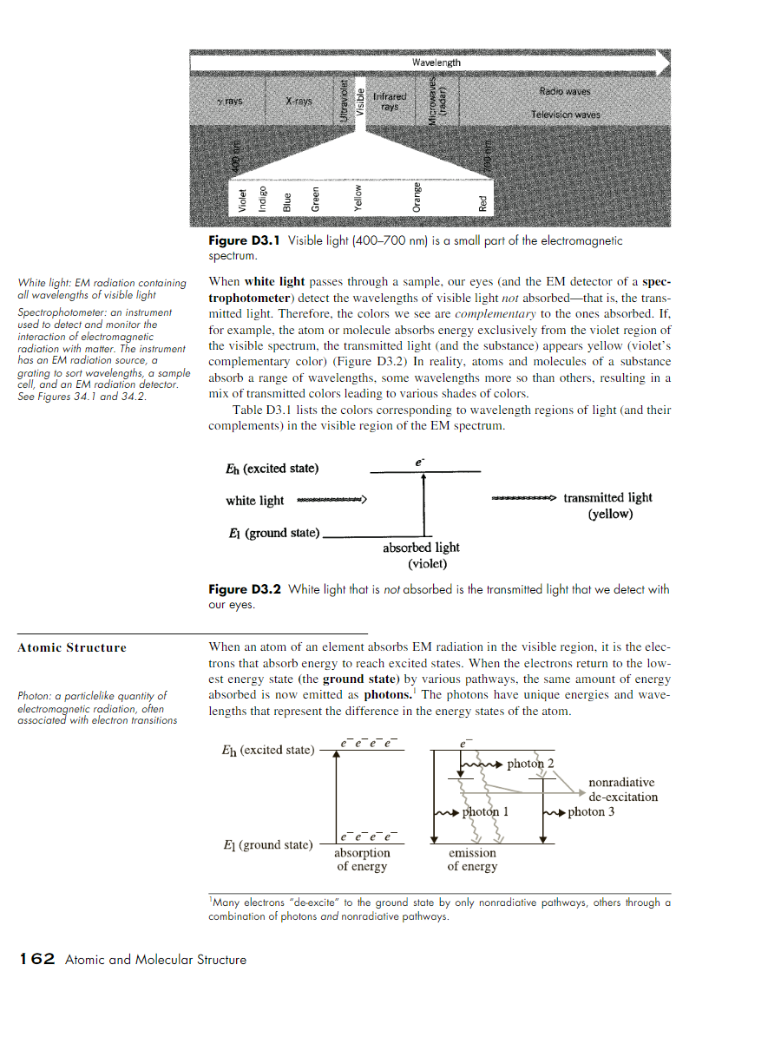

Slide 12
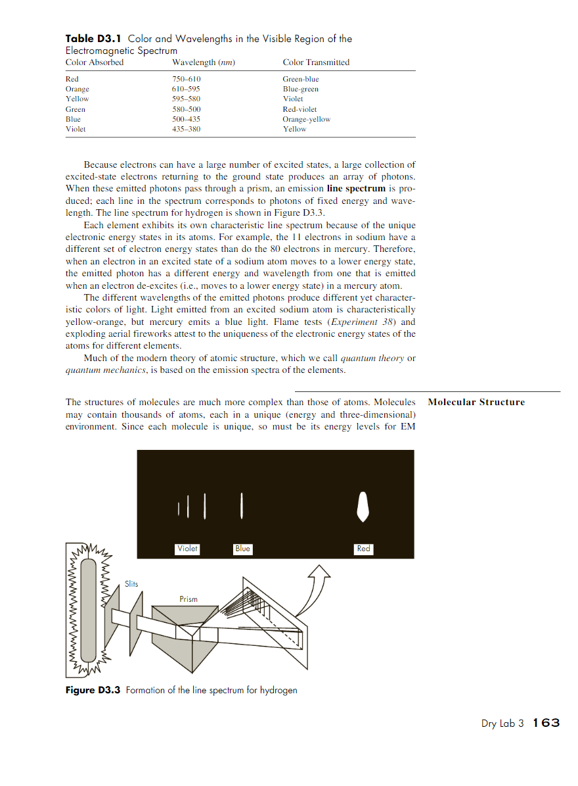
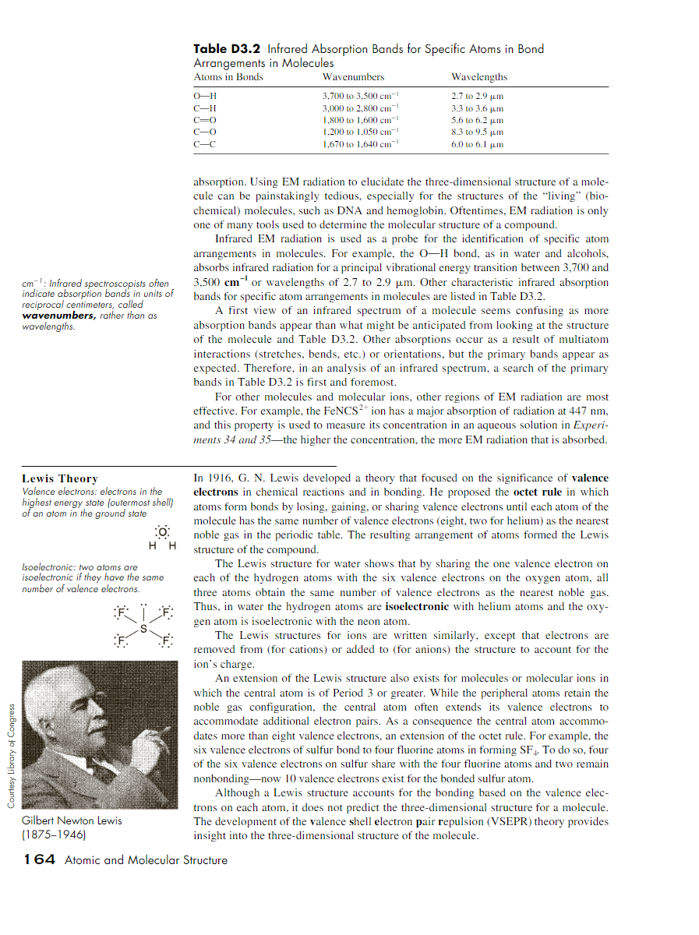

Slide 13
